Slide 1



Slide 2

AR Interior Design ”Realize Your Imagination in 3D”
Supervised by:
Mr.Armughan Ali
Group Members:
Hammad Ali(FA17-BCS-089)
M Waris Ali (FA17-BCS-092)
Department of Computer Science
COMSATS University Islamabad, Attock Campus

Slide 3
Outline
Introduction
Working flow
Problem statement
Objectives
Methodology
Functional Requirements
Comparison table
Modern tools
Benefits
Diagrams
System Screenshots
References

Slide 4

Introduction
Augmented Reality (AR) is an interactive experience of a real-world environment.
The AR Interior Design provide the users “Virtual Ornamentation” of their living and working Space.
We provide the traditional Augmented Reality platform through an Android based application for various organizations and famous companies like IKEA (European multinational group).
Our application offers customized 3D experience of products that permit the customers to personalize their home interior and change the look of their room with few taps on the screen.

Slide 5
Working flow
Start
Select object from database
Start Video Capturing
NO
Take an image Frame
Marker Detected ?
Process and Extract matching marker Features
Yes
Highlight Marker and calculate the Position
Super Impose object on the image with the center aligned with marker
Augmented Reality with object Virtually Placed

Slide 6
Problem statement
Our Motivation
Lack of artistic quality in the customers to visualize the décor of their environment.
People end up wasting money and time in decorating their houses and later regret how it ends up.
No platform for the users to have a “look & Feel” before making the purchase.
People do not have idea what they are looking for when visit the stores and often end up buying the wrong object.

Slide 7
Objectives
An App that provides “artistic sense” to the users for interior decoration.
An App that allows the user to select different styles, templates and objects for decoration before the actual purchase.
An App that provides “Look & Feel” for the customers, so that they make the right decisions.
An App that empowers the user when it comes to home decoration.

Slide 8
Methodology
An application that uses the mobile camera to place a marker on the plane surface for placement of object.
Application captures the image and passes it through predefined marker detection algorithm.
Algorithm is based on image processing techniques using colour and other properties as the input to detect the marker. User initially selects the objects to be placed from the given database.
The application superimposes objects on the original image with the centre coinciding with the marker’s centre in both directions.
Objects are overlaid on to the two dimensional image frame acquired from the camera. This will appear as object is actually placed in the real world. And finally the user have the “Look & Feel”

Slide 9
Data Flow Diagram
View image
Respond request
AR Interior Design App
User
Register/login
Camera
User selected 3D Objects
Access to Store/Selection of Model
Object Placed/Image Capture
View profile

Slide 10
Functional Requirements
Signup & Login.
Selection of Objects from the database.
App can access the camera.
Marker Detection & Placement.
Camera captures live video feeds in the real world.

Slide 11
Comparison Table
Android Applications | 3D customizable 3D Objects | Accurate Dimensions | Free of cost | integrated in-app shopping experience
Magic plan room design | yes | no | yes | no
Housecraft designs | yes | no | no | yes
Paint-Tester decorator | no | no | yes | no
AR Interior Design | yes | yes | yes | yes

Slide 12
Modern tools & Development Requirements
Software Requirements dependence:
Android 7.0 or later (some models require newer versions as noted below)
Firebase
UNITY (Real Time Development Platform)
Photoshop, Maya 3D
Microsoft Visio
Database: MYSQL or Firebase
Tools: Android Studio, JDK
C# Language. Java Application.
StarUML
MS Word / PowerPoint for presentations
Hardware Requirements dependence:
Smart Mobile Phone: Android which supports Augmented Reality

Slide 13
Benefits
Better Visualization: AR in interior design help the client visualize before buying.
Customization: Users can customize the decor of their environment by have options of selecting different styles, objects and templates.
This technology further helps in boosting sales graph by elevating the user experience in virtually designed space.
Saves Time & Money: Users can perceive the look of their rooms in advance and buy accordingly.
Aesthetic Sense: App also helps building an artistic sense among the users and educate them a thing or two about interior design and decoration.

Slide 14
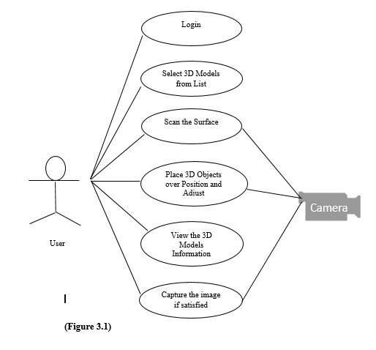
Diagrams (Use Case Diagram)

Slide 15
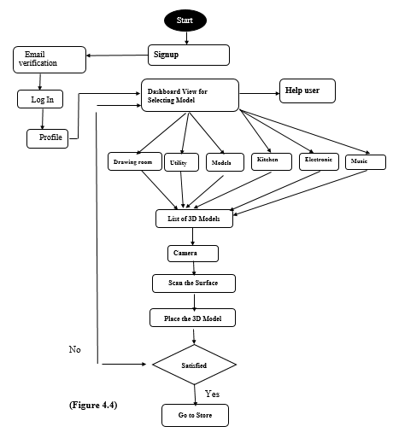
Diagrams (Activity Diagram)

Slide 16

Application Icon

Slide 17
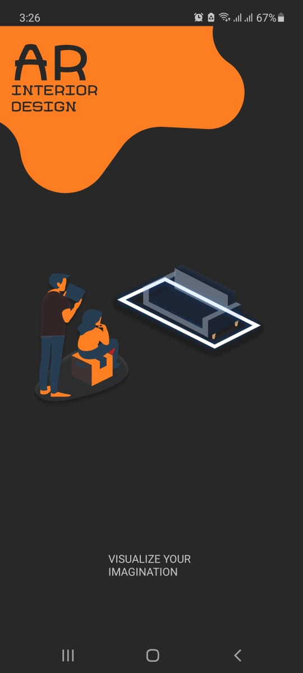
Splash Screen

Slide 18
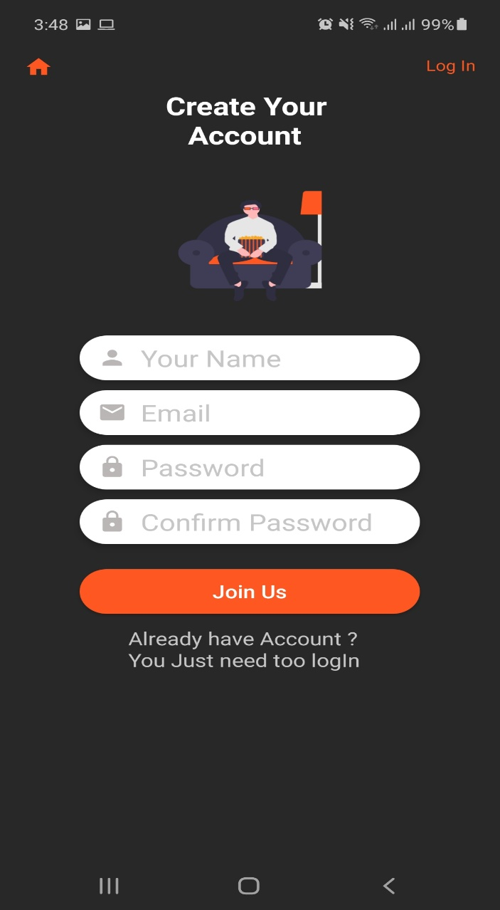
Signup

Slide 19
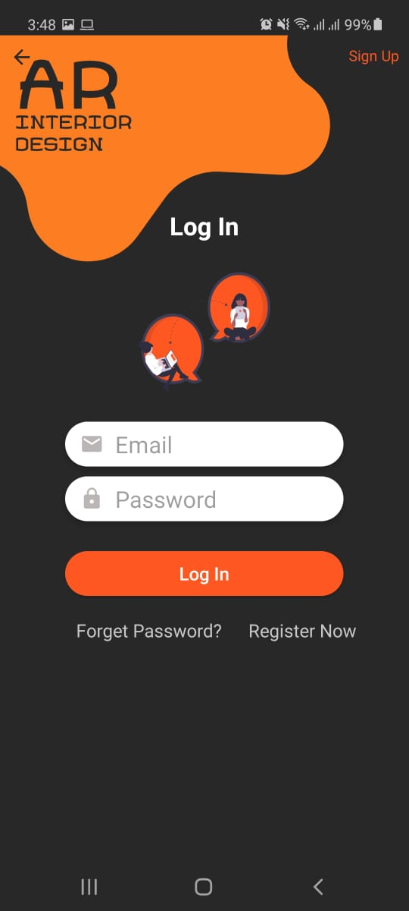
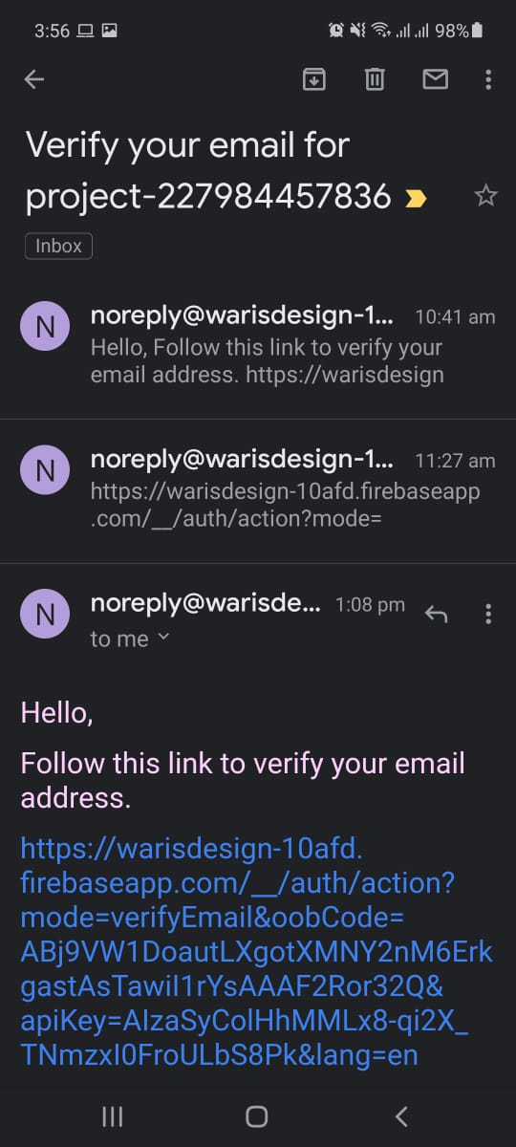
Login

Slide 20
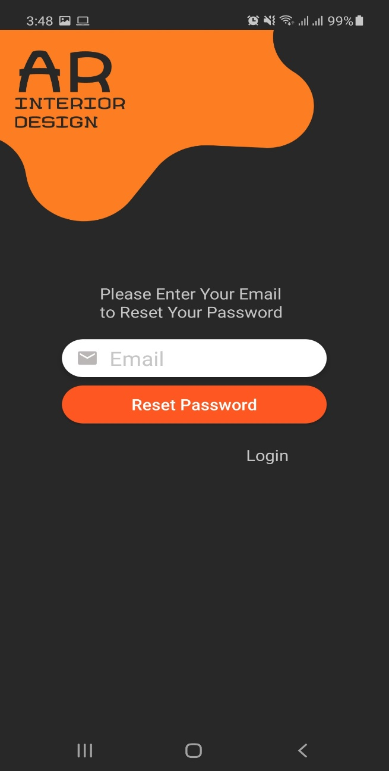
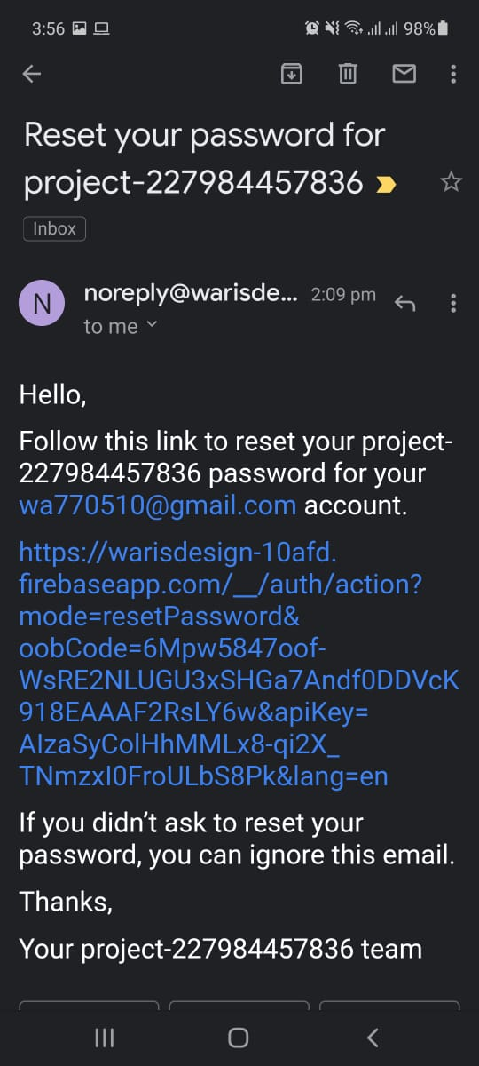
Reset password

Slide 21
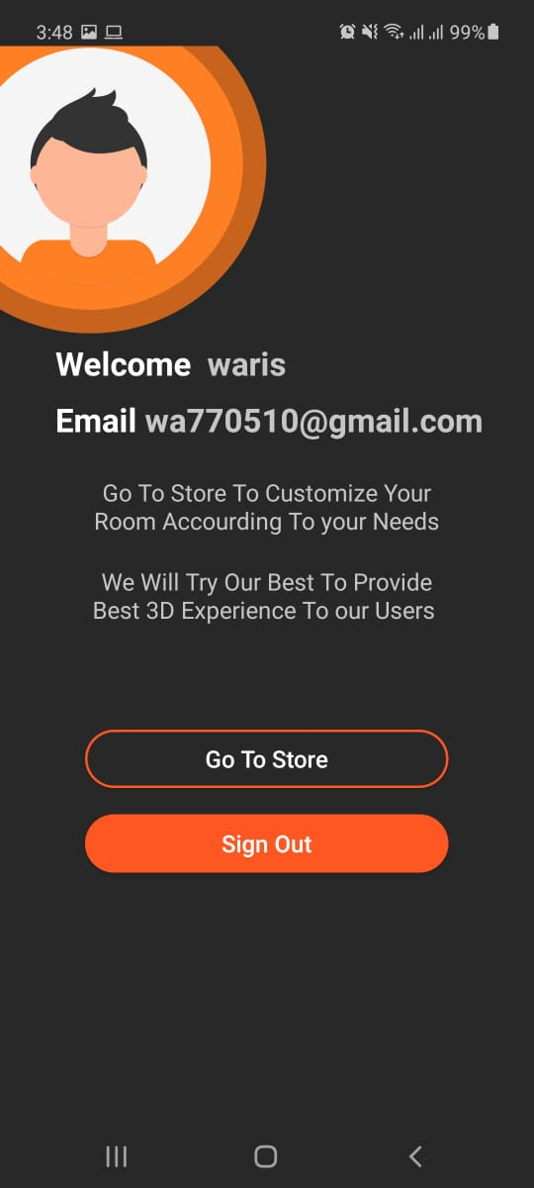
Profile

Slide 22
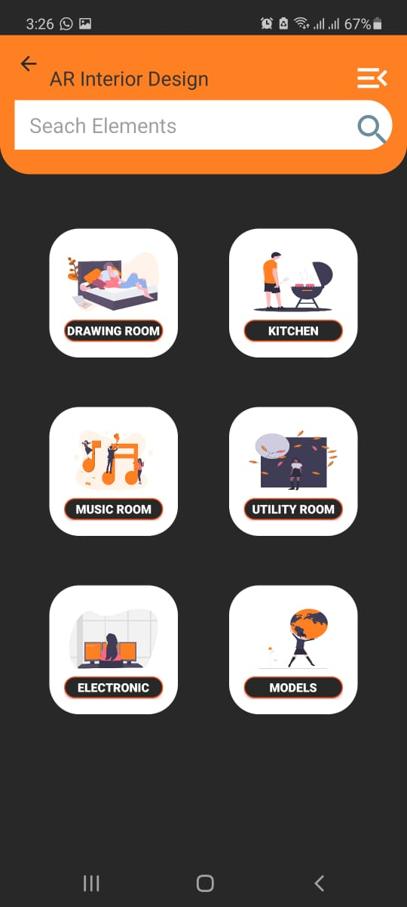
Store

Slide 23
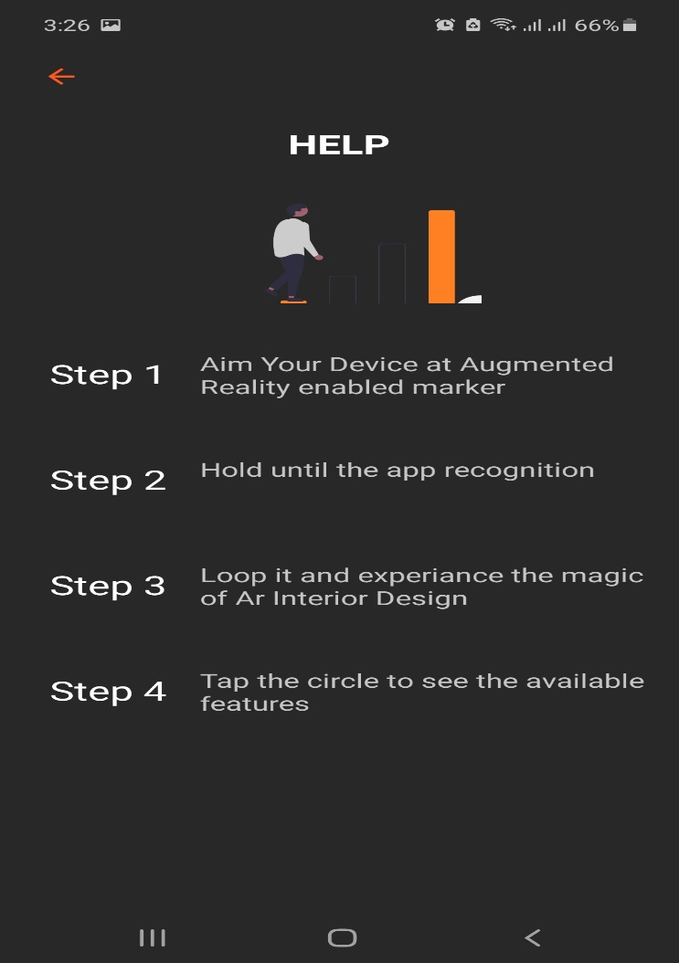
Help

Slide 24
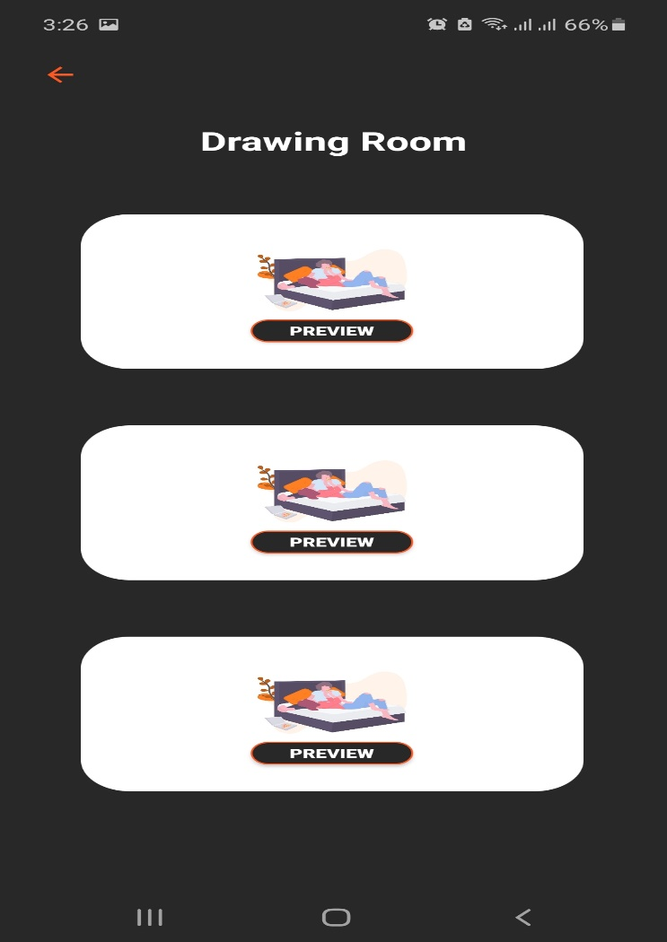
Drawing Room

Slide 25
Conclusion
We have design the interface of our App with Android studio.
Created Almost 10 Activities and give them Good UI design .
We created the log in Sign Up registration system .
Used online Firebase data Server to register user Account .
After registered an email will be send to their account for verification purpose.
After verification User can log in to his/her account .If he forget his password we created another activity which can reset the password for users.
After verifying their email Then we create a dashboard design and divide it with different categories When ever the user select the object from the categories List and preview it camera will open .

Slide 26
References
https://www.slideshare.net/aashishrathod79/augmented-reality-for-interior-design
https://www.slideshare.net/yashkaushik2/augmented-reality-application-final-year-project-62515214
https://www.queppelin.com/augmented-reality-ar-in-interior-designing/
https://www.iosrjournals.org/iosr-jce/papers/Conf.16051/Volume-1/9.%2042-46.pdf?id=7557
https://developers.google.com/ar/develop/c/quickstart
https://www.viewsonic.com/library/education/6-benefits-and-5-examples-of-augmented-reality-in-education/#:~:text=Through%20augmented%20reality%20(AR)%2C,through%20increased%20engagement%20and%20interactivity.&text=Augmented%20Reality%20(AR)%20in%20education,prepare%20students%20for%20the%20future..
https://www.investopedia.com/terms/a/augmented-reality.asp

